Slide 1
Computer Architecture
Concerned with the structure and behavior of computer.
Includes- instruction format, addressing modes, pipelining etc
Concerned with specifications of the various functional module such as memory and processor and structuring them together.

Slide 2
Data Representation
UNIT 1

Slide 3
Data Representation
Data – factual information used for analysis and reasoning.
Information- refined data.
Data Types- numbers, letters and discrete values.

Slide 4
Number System
Representation of numbers.
Base or radix
Conversion
Can be easily converted from one radix to other.
READ YOURSELF

Slide 5
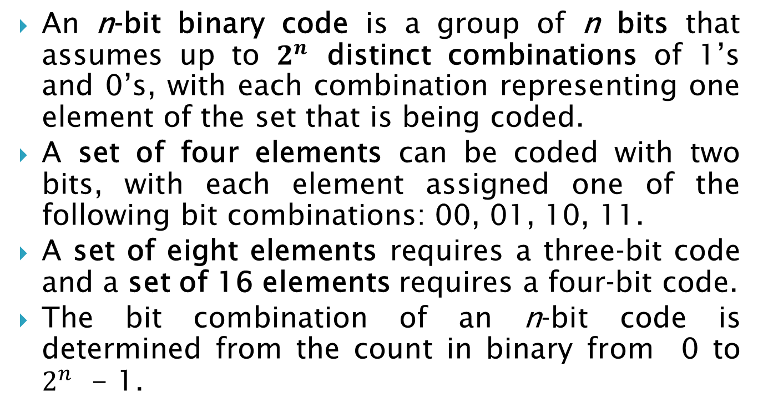
Binary Representation
An n‐bit binary code is a group of n bits that assumes up to $2^{n}$ distinct combinations of 1’s and 0’s, with each combination representing one element of the set that is being coded.
A set of four elements can be coded with two bits, with each element assigned one of the following bit combinations: 00, 01, 10, 11.
A set of eight elements requires a three‐bit code and a set of 16 elements requires a four‐bit code.
The bit combination of an n‐bit code is determined from the count in binary from 0 to $2^{n}$ - 1.

Slide 6
Each element must be assigned a unique binary bit combination, and no two elements can have the same value; otherwise, the code assignment will be ambiguous.
Notes:
abc

Slide 7

Complements
Complements are used for simplifying subtractions.
Two complements
r’s complement- $r^{n }$-N
r-1’s complement- ($r^{n }$-1)-N

Slide 8
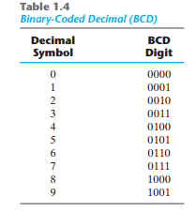
Binary Coded Decimal (BCD)

Slide 9
Alphanumeric codes
Many applications need data as number and letters.
For instance-an insurance company with millions of users. To process files, writing name’s of policy holder, one’s need alphabet too.
So, alphanumeric code is used to represent decimal number, alphabets and some special characters.
ASCII(American Standard code for information Interchange) and EBCDIC(Extended BCD interchange code) are alphanumeric code.
ASCII code uses 7 bit and EBCDIC uses 8 bit.

Slide 10
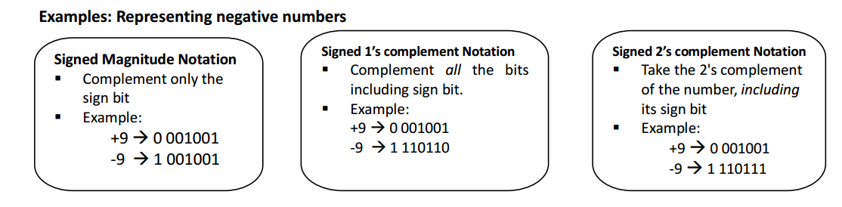
Integer Representation
Signed magnitude Representation
Signed 1’s complement Representation
Signed 2’s complement Representation

Slide 11
Fixed Point Representation
Unsigned and Signed number
Positive number is represented as unsigned numbers
Negative number and positive number(signed number)
-ve Sign and +ve Sign must be used to represent number.
Hardware limitation- all thing represented by 1 and 0.
-ve sign 1
+ve sign 0

Slide 12
Fixed Point Representation
Binary Point
Position of binary point is needed to represent fractions and integers.
Fixed point Representation(Binary point fix at one position) o A binary point in the extreme left of the register to make the stored number a fraction. o A binary point in the extreme right of a register to make the stored number an integer.

Slide 13
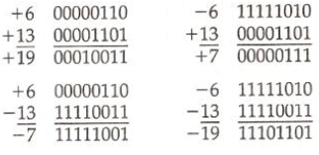
Arithmetic Addition
Sign are same- Add two magnitude and give sum the common sign
If sign are different- subtract smaller magnitude from larger magnitude and give sign that has larger magnitude
2’s Complement addition
If negative numbers are in 2’s complement form, addition need no comparison.
Add two numbers including sign bit and discard any carry out of sign bit.

Slide 14
Overflow
When two numbers of n digits are added and the sum occupies n+1 digits, we say that an overflow has occurred.
n+1 bits can't be accommodated in a register with a standard length of n-bits.
For this reason many computers detect the occurrence of an overflow setting corresponding flip-flop.
An overflow may occur if two numbers added are both positive or both negative. For example: two signed binary numbers +70 and +80 are stored in two 8-bit registers.

Slide 15
Overflow Detection
An overflow condition can be detected by observing two carries: carry into the sign bit position and carry out of the sign bit position.
If these two carries are equal ==> no overflow If these two carries are not same ==> overflow condition is produced. If two carries are applied to Exclusive OR gate, then overflow will be detected if output is 1.

Slide 16
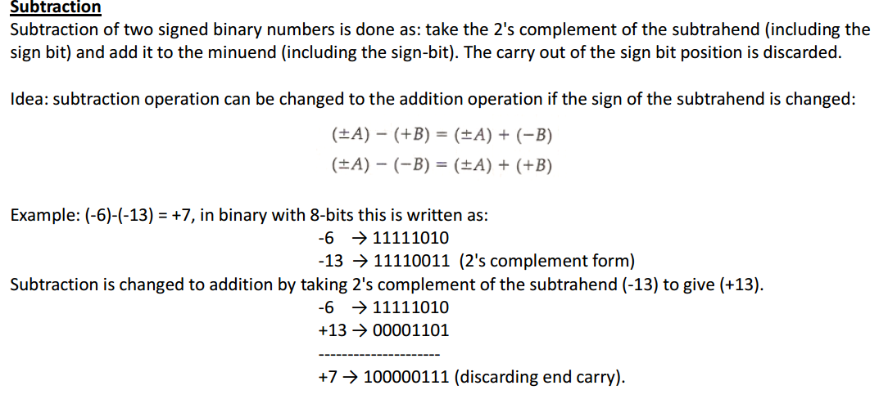
Arithmetic Subtraction

Slide 17
Gray Code or Reflected Code
It is a binary coding scheme.
Used to represent digits generated from a mechanical sensor that may be prone to error.
Used in telegraphy in the late 1800s.
Gray code was patented by Bell Labs researcher Frank Gray in 1947.
In Gray code, there is only one bit location different between two successive values, which makes mechanical transitions from one digit to the next, and is less error prone.

Slide 18
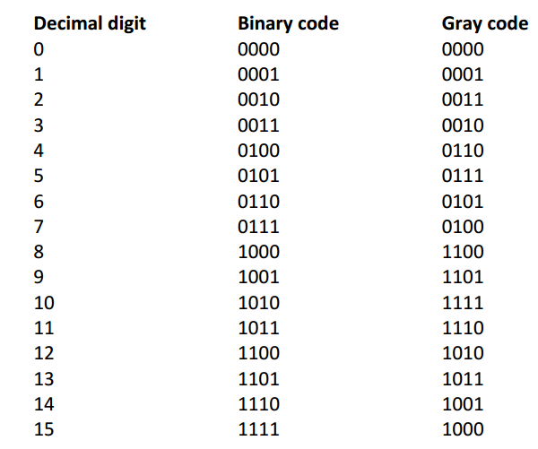

Slide 19
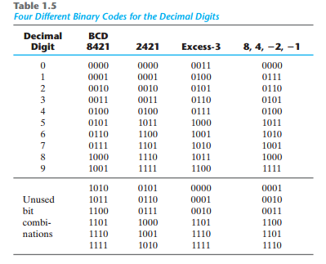
84-2-1, 2421,excess-3

Slide 20
Self complementing code
8421, 2421, 84-2-1 are self complementing code.
Has property- 9’s complement can be obtained directly by complementing 1’s to 0’s and 0’s to 1’s in binary.

Slide 21
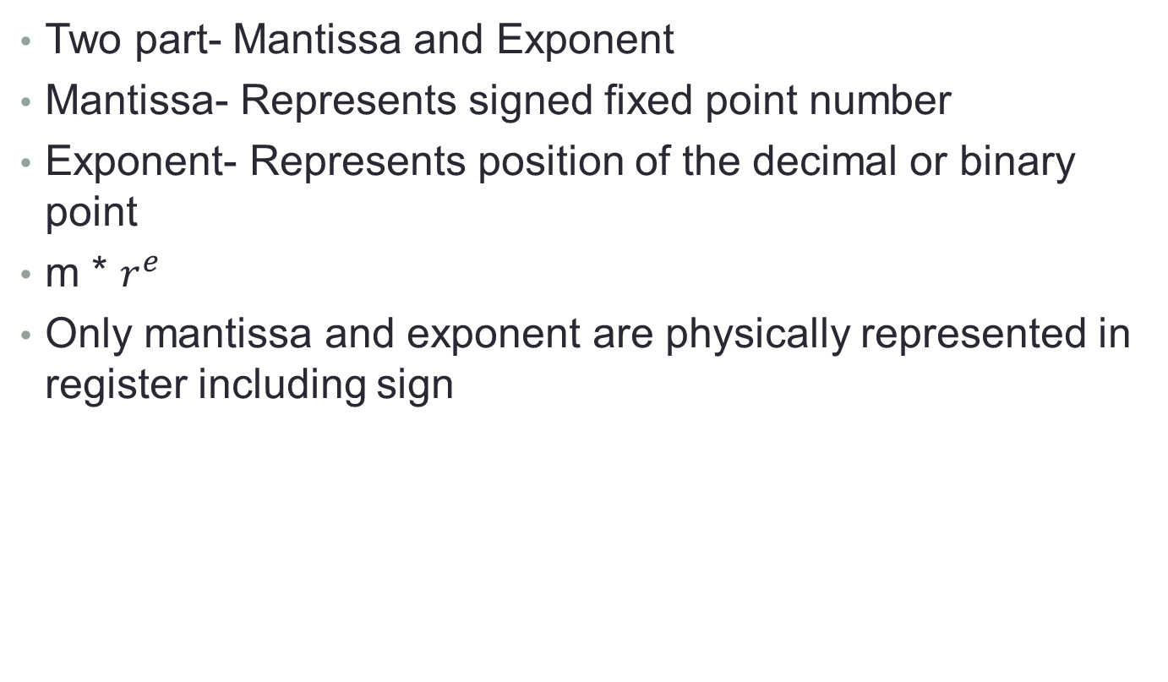
Floating Point Representation
Two part- Mantissa and Exponent
Mantissa- Represents signed fixed point number
Exponent- Represents position of the decimal or binary point
m * $r^{e}$
Only mantissa and exponent are physically represented in register including sign

